Slide 1
COMP5423 Natural Language Processing

Slide 2
Text Normalization and Representation

Slide 3
Outline
Learning Objectives
Text Normalization (Pre-Processing)
Tokenization, Normalization and Segmentation
Morphological Analysis
Stemming and Lemmatization
Text (Document/Sentence) Representation
Bag-of-Words (BOW) Representation
Vector Representation and Vector Space Model
Term Weighting Schemes

Slide 4




Natural Language Understanding Hierarchy
Morphological Analysis
Syntactic Analysis
Semantic Analysis
Discourse Analysis
Tokenization, Lemmatization,
Stemming,
Word Segmentation
Word Sense Disambiguation,
Word Embedding
Word-Level
Part-of-Speech Tagging, Syntactic Parsing, Chunking/Shallow Parsing
Semantic Role Labeling, Frame Semantic Parsing, Abstract Meaning Representation
Text Granularity
Sentence-Level
Text (normalization )
Pre-Processing
Co-Reference Resolution, Discourse Coherence
Document-Level
Text Representation (Feature Vector)
Classification, Ranking, and Clustering (i.e., Machine Learning) Models/Algorithms
Natural Language Processing Applications

Slide 5
Text Normalization
Text Pre-Processing (Normalization)
Sentence Segmentation
Word Tokenization
Word Normalization
Word Lemmatization/Stemming

Slide 6
Text Normalization
Sentence Segmentation
Sentence segmentation is an important first step in text pre-processing.
The most useful cues for segmenting a text into sentences are punctuations, like periods “.”, question marks “?”, and exclamation points “!”.
Ambiguity with Periods
Sentence Boundary
Abbreviation (e.g., Mr. or Inc.)
Number (e.g., 6.66% or 8.8)
Disambiguation is a binary classification task.
Notes:
Sentence segmentation is an important step in text processing. The most useful cues for segmenting a text into sentences are punctuation, like periods, question marks, and exclamation points.

Slide 7
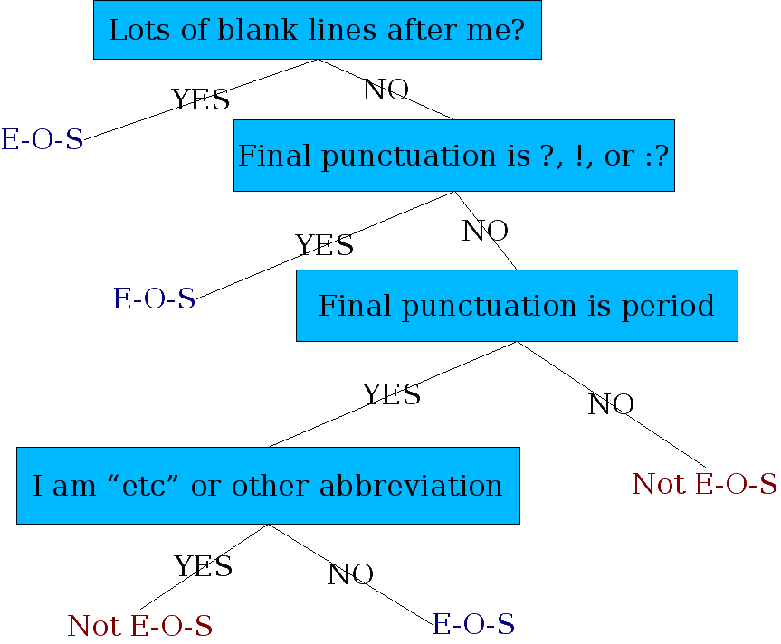
Text Normalization
Sentence Segmentation
Rule-based Classifiers
In the Stanford CoreNLP toolkit, sentence splitting is rule-based.
End Of Sentence
Abbreviation Dictionary
Notes:
semicolon [ˌsemiˈkəʊlɒn]
https://stanfordnlp.github.io/CoreNLP/
In general, sentence tokenization methods work by first deciding (based on rules or machine learning) whether a period is part of the word or is a sentence-boundary marker. An abbreviation dictionary can help determine whether the period is part of a commonly used abbreviation; the dictionaries can be hand-built or machine-learned (Kiss and Strunk, 2006), as can the final sentence splitter.

Slide 8
Text Normalization
Sentence Segmentation
Learning-based Approaches
Classifiers: Decision Tree, Naïve Bayes, SVM, Logistic Regression, etc.
Features: Length of the word with “.”, Case of the word with “.”, Probability of the word with “.” that occurs at EOS, etc.

Slide 9
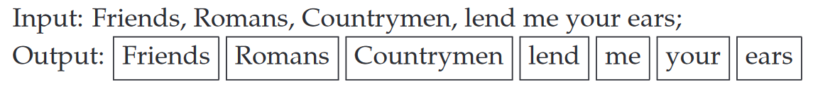
Text Normalization
Word Tokenization
Given a sequence of characters, tokenization is the task of chopping it up into pieces, called word tokens, perhaps at the same time throwing away certain characters, such as punctuations.
Question: How many unique word types and word tokens are there in the sentence “A good wine is a wine that you like”?
Word Tokens
Word Types: Distinct Words
If the set of words in the vocabulary is V, the number of word types is the vocabulary size V.
Word Tokens: Word Occurrences
There are much more tokens, N, in a large corpus than V.
Notes:
9 vs 7
10 vs 8

Slide 10
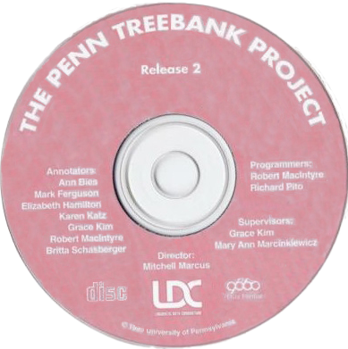
Text Normalization
Word Tokenization
Ambiguity in Tokenization
U.S.A.
T.V.
Ph.D.
$45.55
555,500.50
27/01/2021
http://www.stanford.edu
someone@cs.colorado.edu
Clitic (附着詞):
We’re → We are
→ We ’re
Doesn’t → Does not
→ Does n’t
Hyphenated Words
Two-fold
State-of-the-art
Penn Treebank Tokenization Standard
Notes:
PTB is one of the project supported by LDC (Linguistic Data Consortium), Language Resources
Chapter 3, P15:
We often want to break off punctuation as a separate token; commas are a useful piece of information for parsers, periods help indicate sentence boundaries. But we’ll often want to keep the punctuation that occurs word internally, in examples like m.p.h,, Ph.D., AT&T, cap’n. Special characters and numbers will need to be kept in prices ($45.55) and dates (01/02/06); we don’t want to segment that price into separate tokens of “45” and “55”. And there are URLs (http://www.stanford.edu), Twitter hashtags (#nlproc), or email addresses (someone@cs.colorado.edu).
One commonly used tokenization standard is known as the Penn Treebank to Penn Treebank tokenization standard, used for the parsed corpora (treebanks) released by the Linguistic Data Consortium (LDC), the source of many useful datasets. This standard separates out clitics (doesn’t becomes does plus n’t), keeps hyphenated words together, and separates out all punctuation.

Slide 11
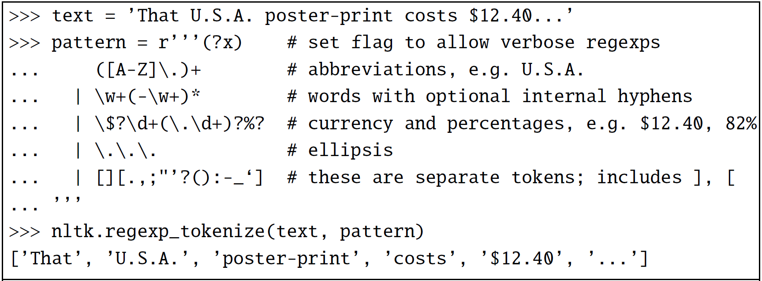
Text Normalization
Word Tokenization
Tokenization based on Regular Expressions
An example of a basic regular expression that can be used to tokenize with the NLTK.regexp tokenize function (NLTK is a Python-based Natural Language Toolkit)
Notes:
P16:
In practice, since tokenization needs to be run before any other language processing, it needs to be very fast. The standard method for tokenization is therefore to use deterministic algorithms based on regular expressions compiled into very efficient finite state automata.

Slide 12
Text Normalization
Word Tokenization
Regular Expressions: Chapter 2.1 in “Speech and Language Processing”
Word Tokenization in Chinese = Chinese Word Segmentation
Sub-word based Tokenization: Modern tokenizers often automatically induce sets of tokens that include tokens smaller than words, e.g., using Byte-Pair Encoding (BPE), from corpus.
Neural Machine Translation of Rare Words with Subword Units, ACL’2016.
Notes:
WordPiece is a subword tokenization algorithm used in natural language processing (NLP) tasks. It breaks down words into smaller units called subword tokens, allowing machine learning models to better handle out-of-vocabulary (OOV) words and improve performance on various NLP tasks.
The tokenizer employed in BERT is based on the WordPiece algorithm,

Slide 13
Text Normalization
Word Normalization
Word normalization is the task of putting words/tokens in a standard format, choosing a single normal form for words with multiple forms.
colour → color
Acronym (首字母縮寫詞) Normalization
U.S.A. → USA, or T.V. → TV
3 December 2014 → 03/12/2014
Time Normalization
Cat → cat
Case-Folding
Notes:
P21:
Word normalization is the task of putting words/tokens in a standard format, choosing a single normal form for words with multiple forms.
For information retrieval or information extraction about the US, we might want see information from documents whether they mention the US or the USA.

Slide 14
Text Normalization
Tokenization and Normalization Tools
Natural Language Toolkit (NLTK)
Book Review: Natural Language Processing with Python, Computational Linguistics, 2010.
Stanford Tokenizer
The Stanford CoreNLP Natural Language Processing Toolkit, ACL’2014.
Specialized Tokenizers for Sentiment
Notes:
emoticons, slangs, self-created words.

Slide 15
Text Normalization
Word Lemmatization and Stemming
Morphological analysis is to study how words are formed, i.e., built up from smaller meaning-bearing units called morphemes.
Two broad classes of morphemes can be distinguished, i.e., stems and affixes.
The stem is the “main” morpheme of the word, supplying the main meaning, while the affixes add “additional” meaning of various kind.
Stemming and lemmatization belong to morphological analysis.
Notes:
Example of Chinese morphe: 们， 子
prefixes [ˈpriːfɪks]
suffixes [ˈsʌfɪks]
Subject-verb agreement

Slide 16
Text Normalization
Word Lemmatization and Stemming
English mainly uses prefixes and suffixes to express inflectional and derivational morphology.
Such an affix usually applies to words of one part-of-speech category and changes them into words of another such category.
Inflectional morphology is relatively simple and includes person and number agreement (-s) and tense markings (-ed and -ing).
adjective-to-noun: -ness (slow → slowness)
adjective-to-adverb: -ly (personal → personally)
noun-to-adjective: -al (recreation → recreational)
noun-to-verb: -fy (glory → glorify)
verb-to-adjective: -able (drink → drinkable)
verb-to-noun (agent): -er (write → writer)
Derivational morphology is more complex and includes suffixes, like -tion, -ness, -able, as well as prefixes like co-, and re-).
Notes:
Lexemes and word forms
The word "word" is ambiguous in common usage. To take up again the example of dog vs. dogs, there is one sense in which these two are the same "word" (they are both nouns that refer to the same kind of animal, differing only in number), and another sense in which they are different words (they can't generally be used in the same sentences without altering other words to fit; for example, the verbs is and are in The dog is happy and The dogs are happy).
The distinction between these two senses of "word" is probably the most important one in morphology. The first sense of "word," the one in which dog and dogs are "the same word," is called lexeme. The second sense is called word form. We thus say that dog and dogs are different forms of the same lexeme.

Slide 17
Text Normalization
Word Lemmatization and Stemming
Lemmatization is to reduce inflectional forms (surface forms) and sometimes derivationally related forms of a word to a common lemmatized (base, root) form or lemma.
It also replaces “am”, “are” and “is” with “be”, and changes “saw” and “seen” to “see”.
translate
translates
translated
translating
translation
translate
A lemma is the canonical form or dictionary form of a word.
Notes:
irregular verbs
Begin
Do
Drive
Fall
Give
Go
Know
See
Swim
Take

Slide 18
Text Normalization
Word Lemmatization and Stemming
Stemming is a naive version of morphological analysis which simply strip off affixes.
It is preferable for applications like information retrieval in which exact morphological structure is not needed.
translate
translates
translated
translating
translation
translat
Notes:
Naïve approach to morphological analysis is stemming.

Slide 19
Text Normalization
Word Lemmatization and Stemming
On-Line English Stemming Demos
Javascript Porter Stemmer Online
Stemming and Lemmatization with Python NLTK
This was not the map we found in Billy Bones's chest, but an accurate copy, complete in all things-names and heights and soundings-with the single exception of the red crosses and the written notes.
Thi wa not the map we found in Billi Bone ' s chest but an accur copi, complet in all thing - name and height and sound - with the singl except of the red cross and the written note.
Notes:
http://snowball.tartarus.org/demo.php
http://nlp.stanford.edu/IR-book/html/htmledition/stemming-and-lemmatization-1.html
published in journal “Program: electronic library and information systems”

Slide 20
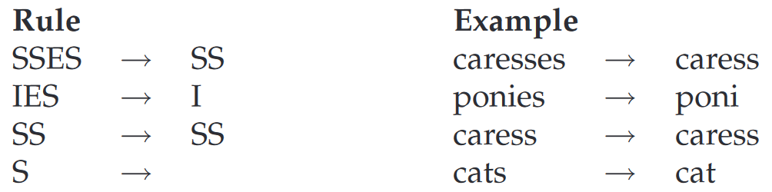
Text Normalization
Word Lemmatization and Stemming
Examples of Porter Stemming Rules
Porter Stemming Algorithm
An Algorithm for Suffix Stripping (M.F. Porter, 1980)
The algorithm is based on series of rules run in series, as a cascade, in which the output of each pass is fed as input to the next pass.
Notes:
http://snowball.tartarus.org/demo.php
http://nlp.stanford.edu/IR-book/html/htmledition/stemming-and-lemmatization-1.html

Slide 21
Text Normalization
Morphological Analysis for Chinese
Chinese is not a language with morphological variations.
English:
The machine translation system is a practical tool that can help us translate one language into another.
Chinese:
機器翻譯系統是一種能夠幫助我們將一種語言翻譯成另外一種語言的實用工具。
English:
They are boys. She is a girl.
Chinese:
他們是男孩。她是女孩。
Notes:
The third person Verb singular [ˈsɪŋɡjələr] and plural [ˈplʊrəl]
prefixes [ˈpriˌfɪks] and suffixes [ˈsʌfɪks]

Slide 22
Text Normalization
Morphological Analysis for Chinese
Chinese Word Tokenization: Word Segmentation
For a language like Chinese, where text is written without any spaces between words, we can perform word segmentation using dictionary based, statistical based or machine learning based approaches.
莎拉波娃现在居住在美国东南部的佛罗里达。今年4月9日，莎拉波娃在美国第一大城市纽约度过了18岁生日。生日派对上，莎拉波娃露出了甜美的微笑。
莎拉波娃 现在 居住 在 美国 东南部 的 佛罗里达。今年 4月 9日，莎拉波娃 在 美国 第一 大 城市 纽约 度过 了 18岁 生日。生日 派对 上，莎拉波娃 露出 了 甜美 的 微笑。

Slide 23
Text Normalization
Chinese Word Segmentation
Dictionary-based Word Segmentation
Basically, dictionary-based segmentation is to match a Chinese character string against the words in a dictionary.
The successfully matched string is segmented as a word.
Matching Direction: Forward Matching vs. Backward Matching
Matching Length Priority: Maximum Matching vs. Minimum Matching
Notes:
The core part of this approach is the dictionary. The dictionary is normally pre-compiled. Obviously, the key technique of this approach is simply string matching. Matching can be performed in two directions. Forward matching matches the strings from left to right, while backward matching starts the matching from the last character and then look back to the first one. The length of the string is another fact to be considered. Think about if three characters match a word in the dictionary, and the two of them also match a word, then shall we consider the three characters as a word or the two characters as a word? So we consider maximum matching or minimum matching.

Slide 24
Text Normalization
Chinese Word Segmentation
Dictionary-based Word Segmentation with Forward Maximum Matching
Let MaxLen represent the maximum word length.
(1) From left to right, select a sub-string from input with the length of MaxLen and match it with the words in a dictionary.
(2) If the matching is successful, then insert a space (or any symbol indicating boundaries) at the end of this sub-string, move forward with MaxLen and repeat the matching step.
(3) Otherwise, reduce one character from the end of the string, and match again until a word is found.

Slide 25
Text Normalization
Chinese Word Segmentation
Dictionary-based Word Segmentation with Forward Maximum Matching
(4) If a two-character string still cannot be located in the dictionary, then regard the current single character as a word (i.e., an isolated word, not necessarily a real word), move to the next and repeat the matching step.

Slide 26
Text Normalization
Chinese Word Segmentation
Dictionary-based Word Segmentation with Forward Maximum Matching
Example: Segment the character string of 後天我們去北京 with the forward maximum matching approach (Let MaxLen=4) and a given dictionary {後天,我們,去,北京}.
後天我們
後天我
後天
後天 ∧
我們去北
我們去
我們
我們 ∧
去北京
去北
去 ∧
北京

Slide 27
Text Normalization
Chinese Word Segmentation
Dictionary-based Word Segmentation with Forward Minimum Matching
(1) From left to right, select a sub-string with two characters and match it with the words in a dictionary.
(2) If it is matched successfully, move two characters ahead and match again.
(3) Otherwise, add one character each time and match again until the word is found.
(4) When the length=MaxLen and the matching still fails, regard the current character as a word.

Slide 28
Text Normalization
Chinese Word Segmentation
Dictionary-based Word Segmentation with Forward Minimum Matching
Example: Segment the character string of 後天我們去北京 with the forward minimum matching approach (Let MaxLen=4) and a given dictionary {後天,我們,去,北京}.
後天
後天 ∧
我們
我們 ∧
去北
去北京
去 ∧
北京

Slide 29
Text Normalization
Chinese Word Segmentation
Question 1: Why is the parameter MaxLen is ofen set to 4?
Question 2: Compare the maximum matching and minimum matching strategies, which one do you believe is more computationally effective, and why?
Question 3: What should be noted when using backward matching? Take “後天我們去北京” as an example.
Performance of Dictionary-based Word Segmentation
In general, backward matching is more accurate than forward matching. Both can achieve above 95% of accuracy.

Slide 30
Text Normalization
Chinese Word Segmentation
On-Line Word Segmentation Demos and Tools
CKIP (for Traditional Chinese Only)
LTP (for Simplified Chinese)
NLPIR (for Simplified Chinese)
Examples: 內存在漲價。中國人。他馬上就來。他從馬上摔下來。你們後天再來吧，到家後天就黑了。這種病的病因到目前為止醫學界都不清楚，他的病因我而起。習近平，男，漢族，1953年6月生，陝西富平人。
Notes:
Sample: 內存在漲價。中國人。他馬上就來，他從馬上摔下來。你們後天再來吧，到家後天就黑了。這種病的病因到目前為止醫學界都不清楚，他的病因我而起。習近平的每一次講話都沒有大話。
http://www-rohan.sdsu.edu/~chinese/annotate.html
研究生命的起源， 内存在涨价 ， 中国人
他將來會去上海, 他將來上海
他马上就来, 他从马上摔下来了
你们后天再来吧, 到家后天就黑了
你顺着这条大路一直往前走就到了, 长这么大路都不会走
这种病的病因到目前为止医学界都不清楚, 她的病因我而起
我们公司需要的这种人才目前非常难找, 他这个人才不怕呢我的人生之路有你陪伴，真是我的福气,
你们之间的个人恩怨我管不了, 我见到这个人的时候天色已经很晚
哪个人生下来就会算算术呢
没有出众的才能就无法在竞争中站稳脚跟, 掌握新技术才能立于不败之地
语言学是一门古老而又年轻的学问, 什么语言学起来都不是件容易的事情
这个大款养了一群打手替他开路, 小明妈妈打小明的时候不仅打手还打屁股
這樣的人才能經受考驗

Slide 31
Text Normalization
Chinese Word Segmentation
Ambiguity in Word Segmentation
Overlapping Ambiguity (90%): The string ABC may be segmented into AB ∧ C or A ∧ BC, when AB ∈ W and BC ∈ W, W is a collection of words in a dictionary.
計算機會下象棋
她的確切地址在這兒
計算機 ∧ 會 ∧ 下 ∧ 象棋
她 ∧ 的 ∧ 確切 ∧ 地址 ∧ 在 ∧ 這兒
計算 ∧ 機會 ∧ 下 ∧ 象棋
她 ∧ 的確 ∧ 切 ∧ 地址 ∧ 在 ∧ 這兒

Slide 32
Text Normalization
Chinese Word Segmentation
Ambiguity in Word Segmentation
Grouping Ambiguity (10%): For a string of AB, AB is a word, and meanwhile, A and B itself is also an independent word, i.e., AB ∈ W ∧ A ∈ W ∧ B ∈ W.
學生會聽老師的話嗎
學生會 ∧ 聽 ∧ 老師 ∧ 的 ∧ 話 ∧ 嗎
學生 ∧ 會 ∧ 聽 ∧ 老師 ∧ 的 ∧ 話 ∧ 嗎
Notes:
她的病因我而起
到家後天就黑了
他這個人才不怕呢
長這么大路都不會走

Slide 33
Text Normalization
Sub-Word Segmentation (Sub-Word based Tokenization )
To deal with this unknown word problem, modern tokenizers often automatically induce sets of tokens that include tokens smaller than words, called sub-words, from corpus.
Comparative Adjectives
Superlative Adjectives
lowest: +
lower: +
low
est
low
er
newer: +
new
er
newest: +
new
est
faster: +
fast
er
fastest: +
fast
est
Notes:
Comparative and superlative adjectives
Chapter 2.4.3. P18:
Instead of defining tokens as words (whether delimited by spaces or more complex algorithms), or as characters (as in Chinese), we can use our data to automatically tell us what the tokens should be. This is especially useful in dealing with unknown words, an important problem in language processing.
To deal with this unknown word problem, modern tokenizers often automatically induce sets of tokens that include tokens smaller than words, called sub-words. Sub-words can be arbitrary substrings, or they can be meaning-bearing units like the morphemes -est or -er. (A morpheme is the smallest meaning-bearing unit of a language; for example the word unlikeliest has the morphemes un-, likely, and -est.)
BPE is used by OpenAI for tokenization when pretraining the GPT model. It's used by a lot of Transformer models, including GPT, GPT-2, RoBERTa, BART, and DeBERTa (BERT/GPT/BART).

Slide 34
Text Normalization
Sub-Word Segmentation (Sub-Word based Tokenization )
Byte-Pair Encoding (BPE) Algorithm
It begins with a vocabulary that is just the set of all individual characters.
Corpus:
{‘lower</w>’: 2, ‘newest</w>’: 6, ‘widest</w>’: 3}
(Token) Vocabulary:
{‘l’, ‘o’, ‘w’, ‘e’, ‘r’, ‘</w>’, ‘n’, ‘s’, ‘t’, ‘i’, ‘d’}
It then examines the corpus, chooses the two symbols that are most frequently adjacent (e.g., ‘e’, ‘s’), adds a new merged symbol ‘es’ to the vocabulary, and replaces every adjacent ’e’ ’s’ in the corpus with the new ‘es’.
Corpus:
{‘lower</w>’: 2, ‘new es t</w>’: 6, ‘wid es t</w>’: 3}
Vocabulary:
{‘l’, ‘o’, ‘w’, ‘e’, ‘r’, ‘</w>’, ‘n’, ‘t’, ‘i’, ‘d’, ‘es’ }
Notes:
Chapter 2.4.3. P18:
Instead of defining tokens as words (whether delimited by spaces or more complex algorithms), or as characters (as in Chinese), we can use our data to automatically tell us what the tokens should be. This is especially useful in dealing with unknown words, an important problem in language processing.
To deal with this unknown word problem, modern tokenizers often automatically induce sets of tokens that include tokens smaller than words, called sub-words. Sub-words can be arbitrary substrings, or they can be meaning-bearing units like the morphemes -est or -er. (A morpheme is the smallest meaning-bearing unit of a language; for example the word unlikeliest has the morphemes un-, likely, and -est.)
The BPE token learner begins with a vocabulary that is just the set of all individual characters. It then examines the training corpus, chooses the two symbols that are most frequently adjacent (say ‘A’, ‘B’), adds a new merged symbol ‘AB’ to the vocabulary, and replaces every adjacent ’A’ ’B’ in the corpus with the new ‘AB’. It continues to count and merge, creating new longer and longer character strings, until k merges have been done creating k novel tokens; k is thus a parameter of the algorithm. The resulting vocabulary consists of the original set of characters plus k new symbols.

Slide 35
Text Normalization
Sub-Word Segmentation (Sub-Word based Tokenization )
Byte-Pair Encoding (BPE) Algorithm
Sub-words can be arbitrary substrings, or they can be meaning-bearing units like the morphemes.
Corpus:
{‘lower</w>’: 2, ‘new est</w>’: 6, ‘wid est</w>’: 3}
Vocabulary:
{‘l’, ‘o’, ‘w’, ‘e’, ‘r’, ‘</w>’, ‘n’, ‘i’, ‘d’, ‘est’ }
……
Notes:
BPE is used by OpenAI for tokenization when pretraining the GPT model. It's used by a lot of Transformer models, including GPT, GPT-2, RoBERTa, BART, and DeBERTa (BERT/GPT/BART).

Slide 36
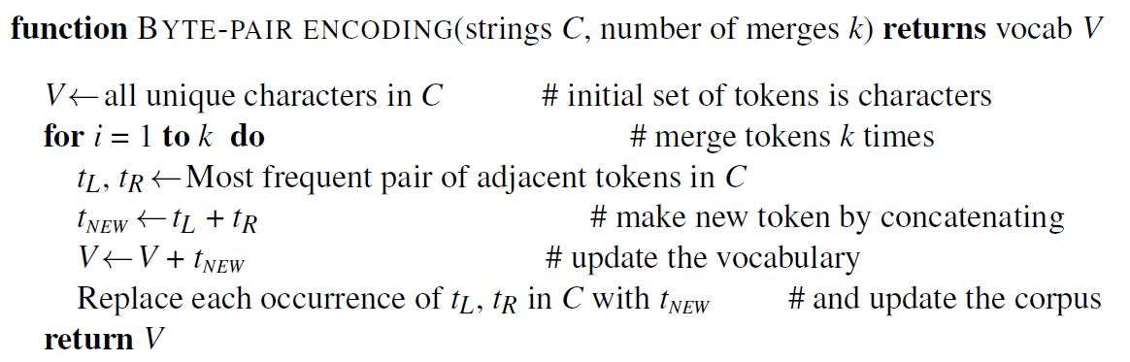
Text Normalization
Sub-Word Segmentation (Sub-Word based Tokenization )
Byte-Pair Encoding (BPE) Algorithm
Neural Machine Translation of Rare Words with Subword Units, ACL’2016.
Notes:
Chapter 2.4.3. P18:
Instead of defining tokens as words (whether delimited by spaces or more complex algorithms), or as characters (as in Chinese), we can use our data to automatically tell us what the tokens should be. This is especially useful in dealing with unknown words, an important problem in language processing.
To deal with this unknown word problem, modern tokenizers often automatically induce sets of tokens that include tokens smaller than words, called sub-words. Sub-words can be arbitrary substrings, or they can be meaning-bearing units like the morphemes -est or -er. (A morpheme is the smallest meaning-bearing unit of a language; for example the word unlikeliest has the morphemes un-, likely, and -est.)
BPE is used by OpenAI for tokenization when pretraining the GPT model. It's used by a lot of Transformer models, including GPT, GPT-2, RoBERTa, BART, and DeBERTa (BERT/GPT/BART).

Slide 37
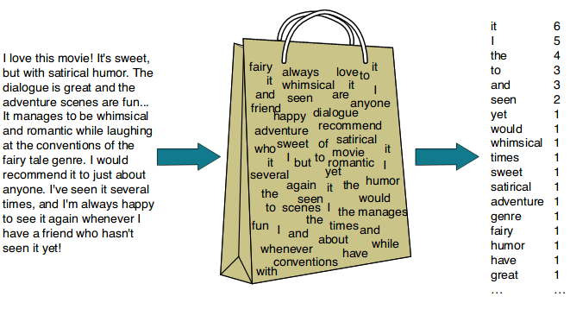
Text Representation
Bag-of-Words (BOW) Representation
A running text (either a document or a sentence) can be simply represented as a set (or a “bag”) of words appearing in it.
The simplest way to create a vocabulary is to bag unique words.
A Bag of Unique Words
Notes:
As the name suggests, we are creating a bag of unique words. The simplest way to create a vocabulary is to bag unique words.
Why?

Slide 38
Text Representation
Bag-of-Words (BOW) Representation
Representative Words
Representative words are those such as “adventure”, “humor” and “sweet”, etc., whose semantics helps in remembering main themes of documents.
Non-Representative Words
Non-representative words are those such as “of”, “the” and “that” etc.
Words, which are too frequent among the documents are not good discriminators.

Slide 39
Text Representation
Bag-of-Words (BOW) Representation
Stop Words
Such non-representative words are frequently referred to as stop words, and normally filtered out.
Classical information retrieval (IR) models consider that each document is represented by a set of representative words, called index terms.
a, about, above, after, again, against, all, am, an, and, any, are, as, at, be, because, been, before, being, below, between, both, but, by, can, did, do, does, doing, don, down, during, each, few, for, from, further, had, has, have, having, he, her, here, hers, herself, him, himself, his, how, i, if, in, into, is, it, its, itself, just, me, more, most, my, myself, no, nor, not, now, of, off, on, once, only, or, other, our, ours, ourselves, out, over, own, same, she, should, so, some, such, than, that, the, their, theirs, them, themselves, then, there, these, they, this, those, through, to, too, under, until, up, very, was, we, were, what, when, where, which, while, who, whom, why, will, with, you, your, yours, yourself, yourselves
NLTK’s List of English Stop Words
Notes:
Dozens
several hundred
several thousand

Slide 40
Text Representation
Original
Stemmed
To be, or not to be: that is the question:
Whether ‘tis nobler in the mind to suffer
The slings and arrows of outrageous fortune,
Or to take arms against a sea of troubles,
And by opposing end them? To die: to sleep;
No more; and by a sleep to say we end …
to be or not to be that is the question
whether ti nobler in the mind to suffer
the sling and arrow of outrag fortun
or to take arm against a sea of troubl
and by oppos end them to die to sleep
no more and by a sleep to sai we end …
Tokenized and Normalized
Stop Word Removed
to be or not to be that is the question
whether tis nobler in the mind to suffer
the slings and arrows of outrageous fortune
or to take arms against a sea of troubles
and by opposing end them to die to sleep
no more and by a sleep to say we end …
question
ti nobler mind suffer
sling arrow outrag fortun
take arm sea troubl
oppos end die sleep
sleep sai end …
Index Terms
Notes:
In information retrieval, an index term (also known as subject term, subject heading, descriptor, or keyword) is a term that captures the essence of the topic of a document. Index terms make up a controlled vocabulary for use in bibliographic records.

Slide 41
Text Representation
Vector Space Model
Index terms (Vocabulary)
Documents
 | d₁ | d₂ | d₃
t₁=computer | 1 | 1 | 1
t₂=document | 0 | 1 | 0
t₃=filtering | 0 | 0 | 1
t₄=information | 1 | 0 | 1
t₅=language | 1 | 0 | 0
t₆=library | 0 | 1 | 0
t₇=retrieval | 0 | 1 | 1
t₈=software | 1 | 0 | 0
computer
information
language
software
computer
document
library
retrieval
d₁
d₂
computer
information
retrieval
filtering
d₃
Term-Document Matrix
Each row represents a word in the vocabulary and each column represents a document from some collection.
Dataset

Slide 42
Text Representation
Document Vectors
Binary Weights
Vector Space Model
A vector space is a mathematical structure formed by a collection of vectors.
Question: How many distinct vectors can be represented by an 8-dimentional binary/Boolean space?
Vocabulary
 | d₁ | d₂ | d₃
t₁=computer | 1 | 1 | 1
t₂=document | 0 | 1 | 0
t₃=filtering | 0 | 0 | 1
t₄=information | 1 | 0 | 1
t₅=language | 1 | 0 | 0
t₆=library | 0 | 1 | 0
t₇=retrieval | 0 | 1 | 1
t₈=software | 1 | 0 | 0
computer
document
filtering
information
language
library
retrieval
software
1
0
0
1
1
0
0
1
1
1
0
0
0
1
1
0
1
0
1
1
0
0
1
0
d₁=
d₂=
d₃=
Notes:
256

Slide 43
Text Representation
Vector Space Model
A document is represented as a vector of index terms.
Each dimension corresponds to an index term in the vocabulary.
Thus, if there are n index terms in the dictionary, a document is a n-dimensional vector.
If a term occurs in the document, its value in the vector is non-zero (known as the weight of the term, which can be binary, count, or real-valued).

Slide 44
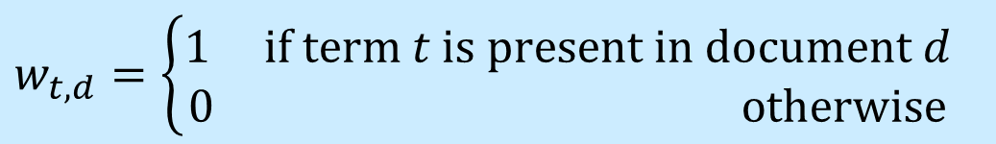
Text Representation
Term Weighting Schemes
Given a set of index terms for a document, not all terms are equally useful for describing document contents.
The importance of these terms for describing document semantic contents is represented by the weights associated to them.
If t is an index term, d is a document, we use w_{t,d} to represent the weight associated with the pair (t, d).
Binary Weight Scheme
$$w_{t,d}=\left\{\begin{aligned}1 if term t is present in document d \\ 0 otherwise\end{aligned}\right.$$

Slide 45
Text Representation
Term Weighting Schemes
Term Frequency (TF)
The term frequency tf_{t,d} of term t in document d is defined as the number of times t occurs in d (i.e., the number of the occurrences of term t in document d).
Assumption: Terms that occur frequently within a document may reflect its meaning more strongly than terms that occur less frequently and thus should have high weights.
Term Frequency
1 2 3 4 5 6 7 8 9 10
10 Terms in a Document

Slide 46
Text Representation
Term Weighting Schemes
Term Frequency (TF)
Frequency of a Term in a Document
computer
document
filtering
information
language
library
retrieval
software
4
0
0
2
4
0
0
5
8
4
0
0
0
3
7
0
6
0
1
9
0
0
5
0
d₁=
d₂=
d₃=

Slide 47
Text Representation
Term Weighting Schemes
Inverse Document Frequency (IDF)
The document frequency is the number of documents containing a particular term.
Assumption: Terms that are limited to a few documents are useful for discriminating those documents from the rest of the collection; while terms that occur frequently across the entire collection are less useful.
Term Frequency
in Documents
A Document Collection of 20 Documents

Slide 48
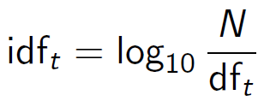

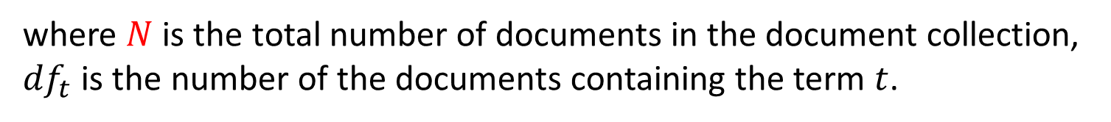
Text Representation
Term Weighting Schemes
Inverse Document Frequency (IDF)
IDF formulates the distribution of terms across the collection as a whole and it is a measure of the general importance of a term t in the document collection.
TF-IDF Weight Scheme
where $N$ is the total number of documents in the document collection, ${df}_{t}$ is the number of the documents containing the term $t$.
$${w_{t,d}={tf}_{t,d}×idf}_{t}$$
Notes:
Take the reciprocal [rɪˈsɪprək(ə)l]
dividing the number one

Slide 49

Text Representation
Term Weighting Schemes
Inverse Document Frequency (IDF)
tf | d₁ | d₂ | d₃
t₁=computer | 4 | 8 | 6
t₂=document | 0 | 4 | 0
t₃=filtering | 0 | 0 | 1
t₄=information | 2 | 0 | 9
t₅=language | 4 | 0 | 0
t₆=library | 0 | 3 | 0
t₇=retrieval | 0 | 7 | 5
t₈=software | 5 | 0 | 0
df
df
3
1
1
2
1
1
2
1
$${idf}_{1}=log\frac{3}{3}, {idf}_{2}=log\frac{3}{1}$$
$${idf}_{3}=log\frac{3}{1}, {idf}_{4}=log\frac{3}{2}$$
$${idf}_{5}=log\frac{3}{1}, {idf}_{6}=log\frac{3}{1}$$
$${idf}_{7}=log\frac{3}{2}, {idf}_{8}=log\frac{3}{1}$$

Slide 50
Text Representation
tf | d₁ | d₂ | d₃ | d₄
t₁ | 1 | 0 | 0 | 1
t₂ | 0 | 1 | 0 | 1
t₃ | 0 | 1 | 1 | 1
t₄ | 0 | 1 | 1 | 0
t₅ | 1 | 1 | 0 | 1
df
2
2
3
2
3
idf
log(4/2)
log(4/2)
log(4/3)
log(4/2)
log(4/3)
tf-idf | d₁ | d₂ | d₃ | d₄
t₁ | 1×log(4/2)=0.30 | 0 | 0 | 1×log(4/2)=0.30
t₂ | 0 | 1×log(4/2)=0.30 | 0 | 1×log(4/2)=0.30
t₃ | 0 | 1×log(4/3)= 0.12 | 1×log(4/3)= 0.12 | 1×log(4/3)= 0.12
t₄ | 0 | 1×log(4/2)=0.30 | 1×log(4/2)=0.30 | 0
t₅ | 1×log(4/3)= 0.12 | 1×log(4/3)= 0.12 | 0 | 1×log(4/3)= 0.12

Slide 51
Text Representation
Term Weighting Schemes
 | d₁ | d₂ | d₃ | d₄
t₁ | 0.30 | 0 | 0 | 0.30
t₂ | 0 | 0.30 | 0 | 0.30
t₃ | 0 | 0.12 | 0.12 | 0.12
t₄ | 0 | 0.30 | 0.30 | 0
t₅ | 0.12 | 0.12 | 0 | 0.12
Feature
Values
Features
0.3
0
0
0
0.12
0
0.30
0.12
0.30
0.12
0
0
0.12
0.30
0
0.30
0.30
0.12
0
0.12
d₁=
d₂=
d₃=
d₄=
Document Vectors

Slide 52
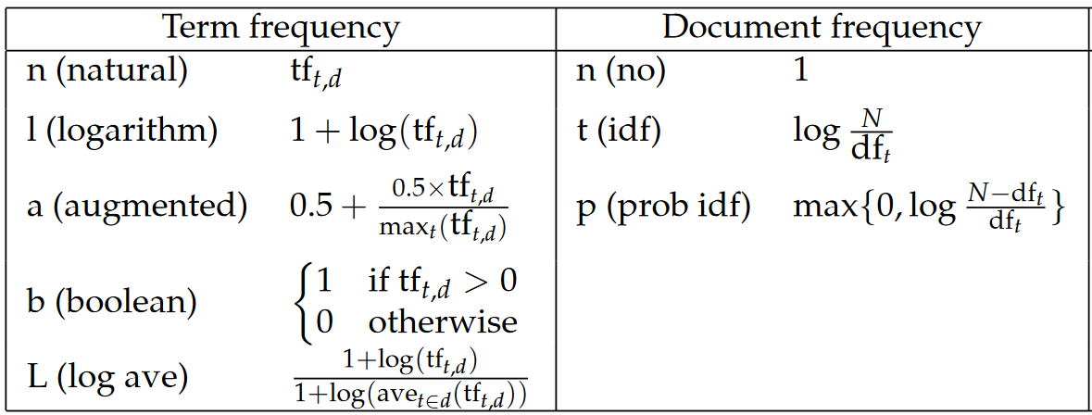
Text Representation
Term Weighting Schemes
TF-IDF Variants

Slide 53
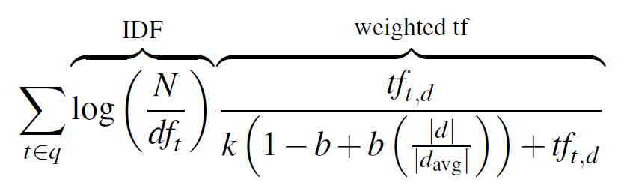
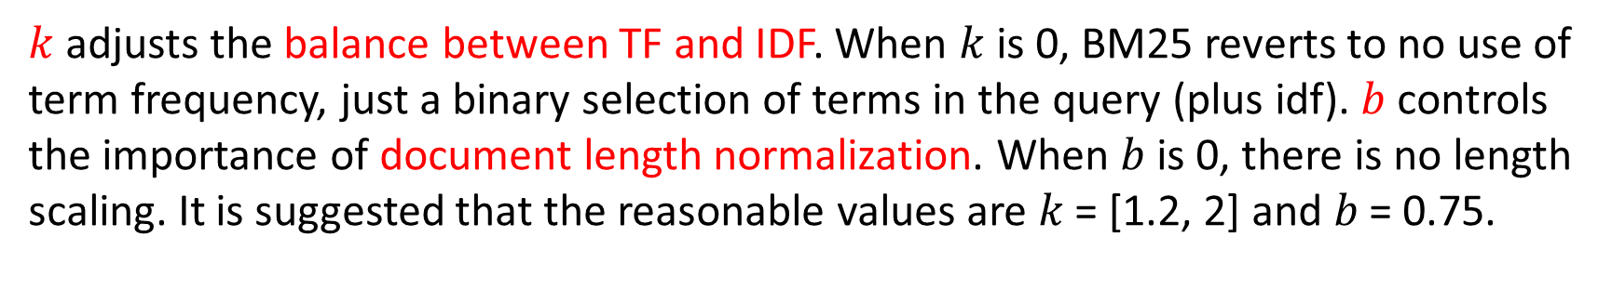
Text Representation
Term Weighting Schemes
(Okapi) BM25 Weighting Scheme
Which BM25 Do You Mean? A Large-Scale Reproducibility Study of Scoring Variants, ECIR’2020.
$k$ adjusts the balance between TF and IDF. When $k$ is 0, BM25 reverts to no use of term frequency, just a binary selection of terms in the query (plus idf). $b$ controls the importance of document length normalization. When $b$is 0, there is no length scaling. It is suggested that the reasonable values are 𝑘 = [1.2, 2] and 𝑏 = 0.75.
Notes:
2020, Chapter, 23 P468
A slightly more complex variant in the tf-idf family is the BM25 weighting scheme (sometimes called Okapi BM25 after the Okapi IR system in which it was introduced in 1995. BM25 adds two parameters: k adjusts the balance between term frequency and IDF, and b, which controls the importance of document length normalization.

Slide 54
Announcement
Lab 1
Venue: PQ604A/B/C
Time: 6:30pm ~ 9:20pm
Date: Tuesday, February 11, 2025
Tutor: Heming Xia

Slide 55
References
Book Chapters
Speech and Language Processing
Chapter 2: Regular Expressions, Text Normalization, and Edit Distance
Chapter 14.1: Information Retrieval
Introduction to Information Retrieval
Chapter 6: Scoring, Term Weighting and the Vector Space Model

Slide 56


